Slide 1
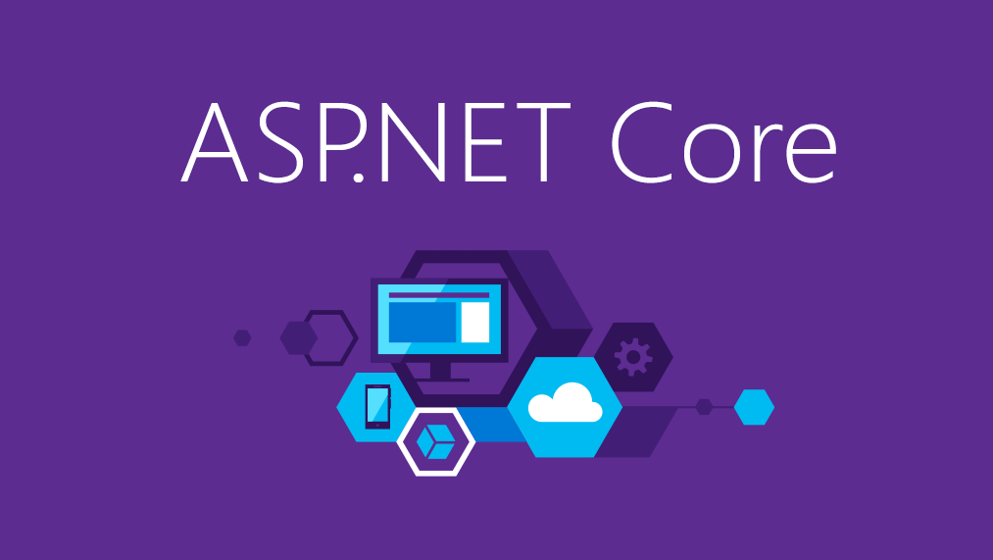
My Story & Features
from
.NET Core 3.0
Vladimir Georgiev
Software Development Lead @ Concep
vladimirgeorgiev.com

Slide 2


Благодарим за подкрепата!
vladimirgeorgiev.com

Slide 3

vladimirgeorgiev.com
Notes:
Моите първи стъпки с .net
Лекции по конференции / Community standup / .NET Conferences worldwide
Мислих, че всичко, което съм видял го знам.
В даден момент осъзнах, че нищо не знам.
Затова трябваше да предприема нещо...

Slide 4

vladimirgeorgiev.com
Notes:
Правих си приложения. Тествах нови функционалности от Asp.Net Core и EF Core.
Имаше нещо различно.
през ръцете ми се материализираше.
Чувството е различно. „Аааа, това е яко“ -> „Аааа, еврика работи“
Но не всичко е толкова хубаво...

Slide 5

vladimirgeorgiev.com
Notes:
Понеже всичко беше алфа версия, не работи от първия път.
Грешно sdk, грешен runtime, грешни версии на пакети.
Когато пък наместя всички версии, то има бъг във .NET

Slide 6

vladimirgeorgiev.com
Notes:
Всички тия грешки бяха от липса на знание, липса на опит или просто не познавах добре framework-a.
За да се оправя исках да разбера как работи всичко.
Искаш и да пиша статии за .NET Core и да споделям неща които никой друг не споделя.
Статии и видеа как работи .NET Core.
Почнах да разучавам Hosting проекта, Kestrel…

Slide 7

Plugin architecture with Asp.Net Core
vladimirgeorgiev.com

Slide 8
Web App
Abstract App
Plugin App 1
eCommerce Adapter
Notes:
Microsoft.Windows.Campatibility

Slide 9
Web App
Abstract App
Assembly
AppDomain
Plugin App 1
Plugin App 3
Caching
TypeFinder
Plugin App 2
Plugin App 4
PluginManager
eCommerce Adapter
Notes:
Microsoft.Windows.Campatibility

Slide 10
What I learn?
Rewriting is not always fun
Rewriting takes time
Don’t rewrite if you aren’t into the code
Don’t rewrite apps without business value

Slide 11

SSO with IdentityServer & Asp.Net Core
vladimirgeorgiev.com

Slide 12
Basic Auth
Basic Auth
Deployment App
Basic Auth
Web API
Customer App
Customer App
Customer App
Customer App
External Systems
vladimirgeorgiev.com

Slide 13
Auth Server
Deployment App
Web API
Customer App
Customer App
Customer App
Customer App
External Systems
vladimirgeorgiev.com

Slide 14
What I have learned?
Understand business
Be patient
But I want new technologies…
Business will ask for it

Slide 15

ASP.NET Core 3.0 Features

Slide 16
Applications now have executables by default
Notes:
Framework-dependent deployment – small, multiple apps-one runtime/sdk
Self-contained deployment – control over runtime/sdk version
An executable matches the environment of the SDK you are using

Slide 17
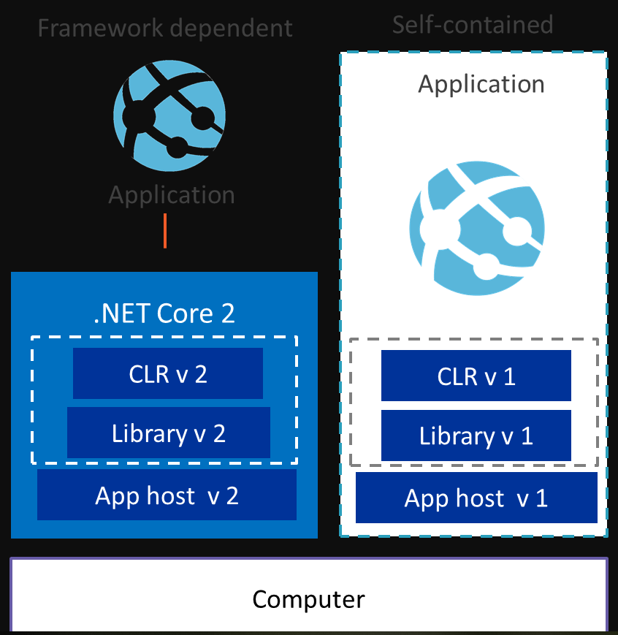
Framework Dependent
Self-Contained

Slide 18
dotnet build now copies dependencies
Notes:
The dependencies are not downloaded to output folder
This change allows you to copy your build output to different machines.

Slide 19
Json.NET
Notes:
Asp.Net Core has dependency to Json.NET until now

Slide 20
Json.NET
Notes:
Asp.Net Core don’t want to be dependent on Json.NET (because it’s hardcoded)
Too slow
There will be integration package for Json.NET

Slide 21
Fast in-box JSON Reader Utf8JsonReader
Notes:
2x faster
Low allocation
build custom parsers and deserializers
It does not allocate until you need to actualize JSON tokens as (UTF16)strings.
In Preview 1: JSON reader (sequential access)
Coming next: JSON writer, DOM (random access), poco serializer, poco deserializer

Slide 22
Utf8JsonReader DEMO
Notes:
https://github.com/dotnet/corefx/issues/33115
ReadOnlySpan<T>?

Slide 23
Assembly Metadata Reading
MetadataLoadContext in .NET Core 3.0
Same as ReflectionOnlyLoad from .NET Framework
Reading assembly metadata without affecting the caller’s application domain
Available in System.Reflection.MetadataLoadContext
Loaded into the reflection-only context
Notes:
To execute code, the assembly must be loaded into the execution context

Slide 24
Assembly Metadata Reading
var paths = new string[] { @"C:\myapp\app.dll" };
var resolver = new PathAssemblyResolver(paths);
using (var lc = new MetadataLoadContext(resolver))
{
Assembly a = lc.LoadFromAssemblyName("app");
Type myInterface = a.GetType("App.IReconnectApplication");
foreach (Type t in a.GetTypes())
{
if (t.IsClass && myInterface.IsAssignableFrom(t))
Console.WriteLine($"Class {t.FullName}");
}
}

Slide 25
Assembly Metadata Reading
var paths = new string[] { @"C:\myapp\app.dll" };
var resolver = new PathAssemblyResolver(paths);
using (var lc = new MetadataLoadContext(resolver))
{
Assembly a = lc.LoadFromAssemblyName("app");
Type myInterface = a.GetType("App.IReconnectApplication");
foreach (Type t in a.GetTypes())
{
if (t.IsClass && myInterface.IsAssignableFrom(t))
Console.WriteLine($"Class {t.FullName}");
}
}

Slide 26
Assembly Metadata Reading
var paths = new string[] { @"C:\myapp\app.dll" };
var resolver = new PathAssemblyResolver(paths);
using (var lc = new MetadataLoadContext(resolver))
{
Assembly a = lc.LoadFromAssemblyName("app");
Type myInterface = a.GetType("App.IReconnectApplication");
foreach (Type t in a.GetTypes())
{
if (t.IsClass && myInterface.IsAssignableFrom(t))
Console.WriteLine($"Class {t.FullName}");
}
}

Slide 27
Assembly Metadata Reading
var paths = new string[] { @"C:\myapp\app.dll" };
var resolver = new PathAssemblyResolver(paths);
using (var lc = new MetadataLoadContext(resolver))
{
Assembly a = lc.LoadFromAssemblyName("app");
Type myInterface = a.GetType("App.IReconnectApplication");
foreach (Type t in a.GetTypes())
{
if (t.IsClass && myInterface.IsAssignableFrom(t))
Console.WriteLine($"Class {t.FullName}");
}
}

Slide 28
Assembly Metadata Reading
var paths = new string[] { @"C:\myapp\app.dll" };
var resolver = new PathAssemblyResolver(paths);
using (var lc = new MetadataLoadContext(resolver))
{
Assembly a = lc.LoadFromAssemblyName("app");
Type myInterface = a.GetType("App.IReconnectApplication");
foreach (Type t in a.GetTypes())
{
if (t.IsClass && myInterface.IsAssignableFrom(t))
Console.WriteLine($"Class {t.FullName}");
}
}

Slide 29


Tiered Compilation – How JIT works?
App Start
JIT
Fast Application Loading
Low application performance
App Start
JIT
Slow application loading
High application performance

Slide 30
Tiered Compilation – How Tiered uses JIT?
App Start
JIT
JIT
Fast application loading
High application performance

Slide 31
Tiered Compilation
Add MSBuild property to the default property group in project file:
Add in configProperties to the runtimeconfig.json:
<TieredCompilation>true</TieredCompilation>
"System.Runtime.TieredCompilation": true

Slide 32
More and more…
Cryptography
AES-GCM
AES-CCM
Import/Export of asymmetric public and private keys from standard formats
No more need of X.509 certificate
IoT
Serial Port APIs support on Linux
GPIO, PWM, SPI and I2C APIs
TLS 1.3 and OpenSSL 1.1.1 on Linux
And many more…
Notes:
Authenticated Encryption with Association Data

Slide 33
AES-GCM & AES-CCM
Namespace: System.Security.Cryptography
using (AesGcm aesGcm = new AesGcm(key))
{
aesGcm.Encrypt(nonce, dataToEncrypt, ciphertext, tag, associatedData);
}
using (AesGcm aesGcm = new AesGcm(key))
{
aesGcm.Decrypt(nonce, ciphertext, tag, decryptedData, associatedData);
}

Slide 34
Import/Export Asymmetric Keys
using (RSA rsa = RSA.Create())
{
byte[] keyBytes = File.ReadAllBytes(args[0]);
rsa.ImportRSAPrivateKey(keyBytes, out int bytesRead);
Console.WriteLine($"Read {bytesRead} bytes, {keyBytes.Length-bytesRead} extra byte(s)");
RSAParameters rsaParameters = rsa.ExportParameters(true);
Console.WriteLine(BitConverter.ToString(rsaParameters.D));
}

Slide 35
The Future of .NET Core
High performance
High quality
High developer productivity
Multi-platform support
Multi-language support
Easy deployment
Minimize chance of errors

Slide 36

?
Vladimir Georgiev
vladimirgeorgiev.com
?
?
?
Notes:
Продължавайте да се развивате
Продължавайте да следите и пробвате новите технологии
Имайте търпение
И не забравяйте, във всичко което правим трябва да има business value.

